Slide 1
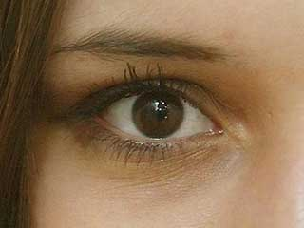
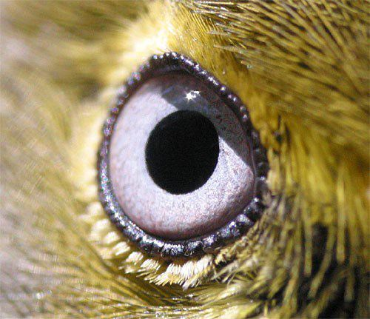

How birds see their world
Behavior & Conservation Lab
California State University Long Beach
E-mail: efernand@csulb.edu
Bird’s Eye View:
http://www.csulb.edu/web/labs/bcl/birdseyeview/

Slide 2
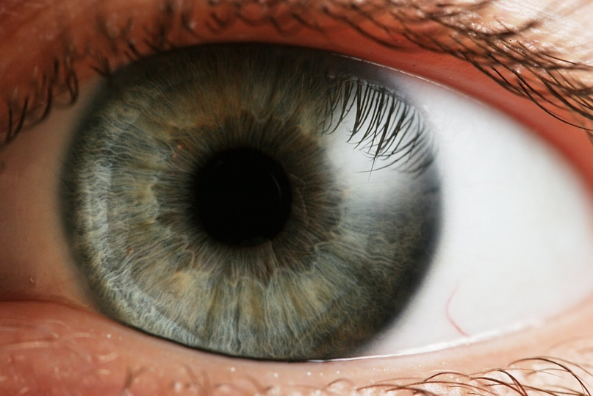
Question?
Please, establish how YOU see their world.
  Colors you perceive.
  Angle around your head from which you can see.
  Maximum distance at which you can read.
  How often you move your eyes.

Slide 3
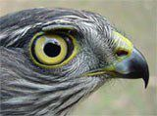
Bird vision is very complex
Color vision (ability to distinguish objects based on the wavelengths of the light they reflect/emit).
  Birds can perceive more colors than humans.
Visual fields (amount of space around the head from which visual information can be gathered).
  HUGE variability among bird species.
Visual acuity (ability to distinguish two objects as different).
  Highly variable among bird species.
Eye movement (tracks visual stimuli).
  Somewhat restricted in birds.

Slide 4
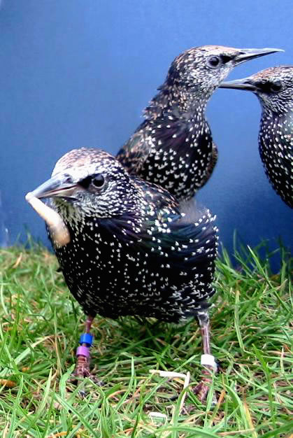
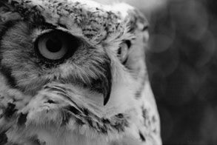
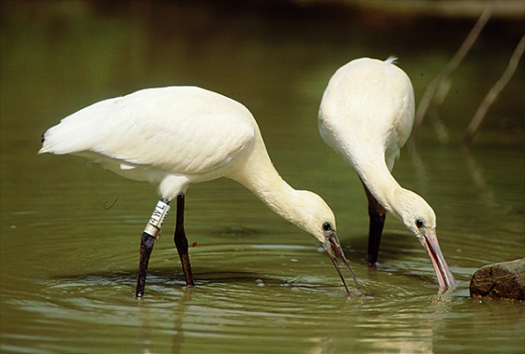
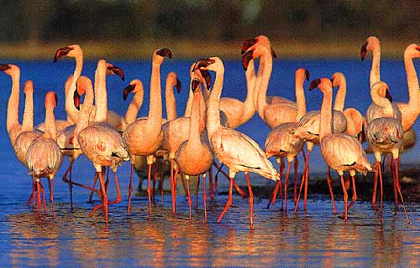
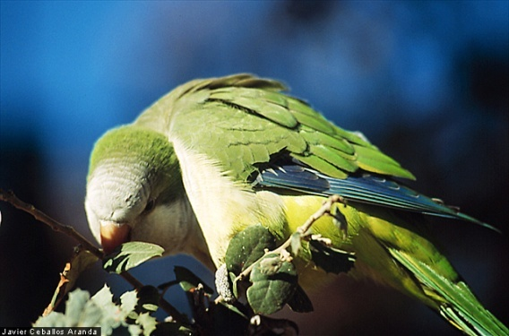
Variability in visual systems in birds
?
Differences in visual systems among species
Reduce predation
?
Improve ability to find food

Slide 5
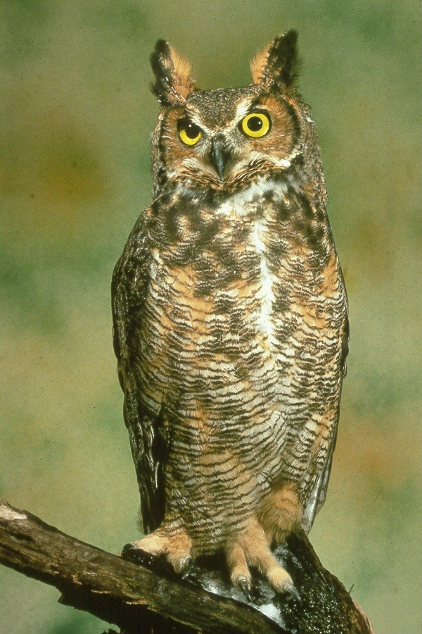
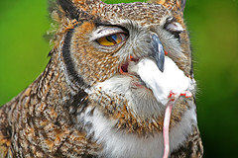
Horned Owl

Slide 6
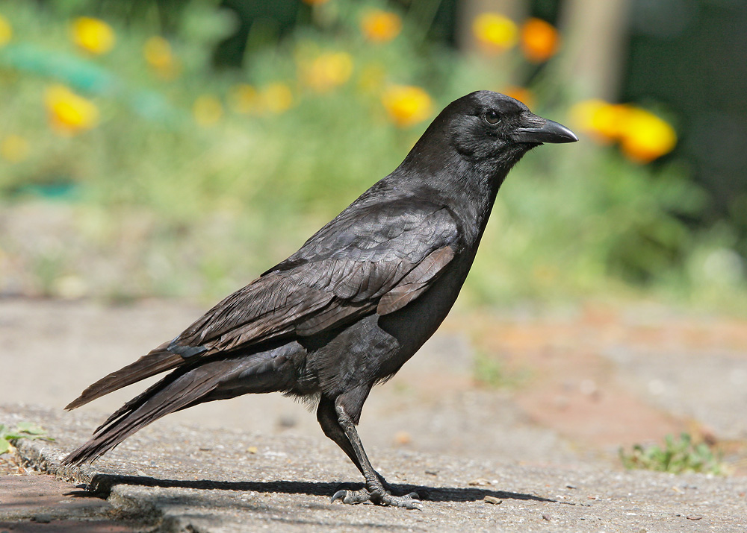
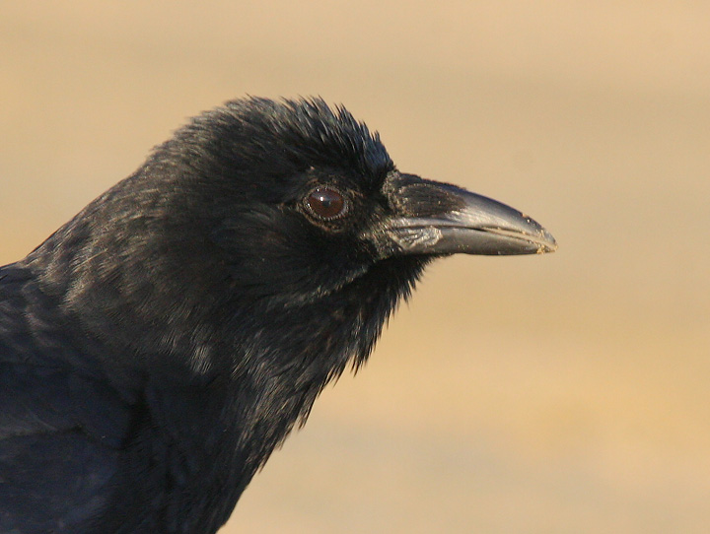
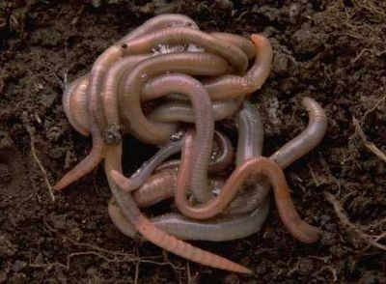
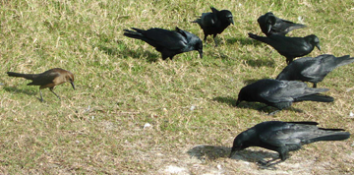
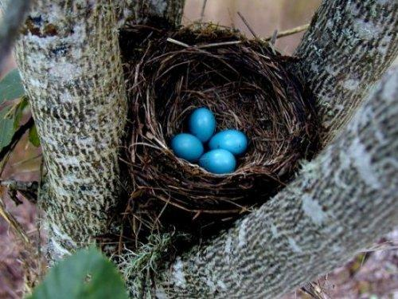
American Crow

Slide 7
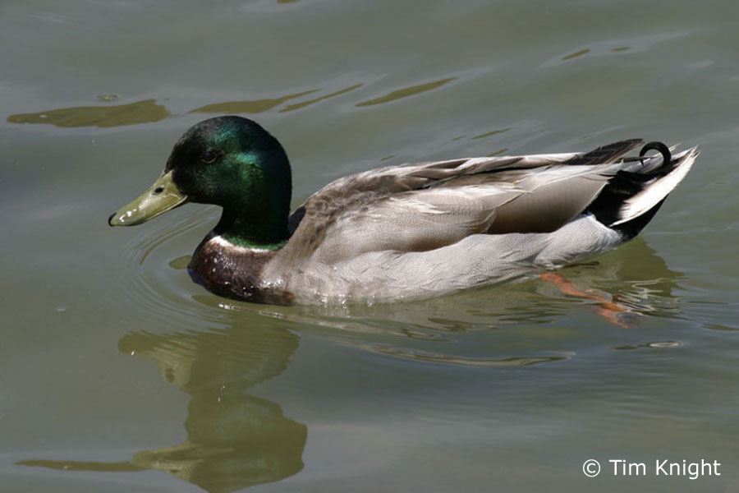
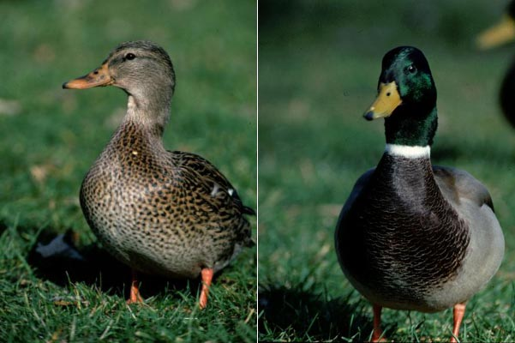
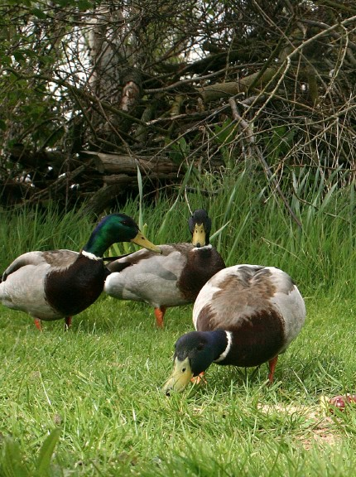
Mallard

Slide 8
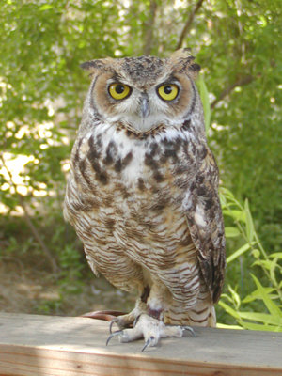
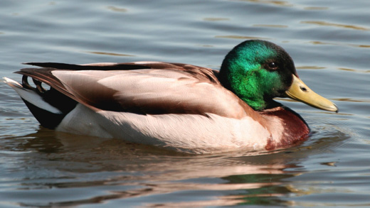
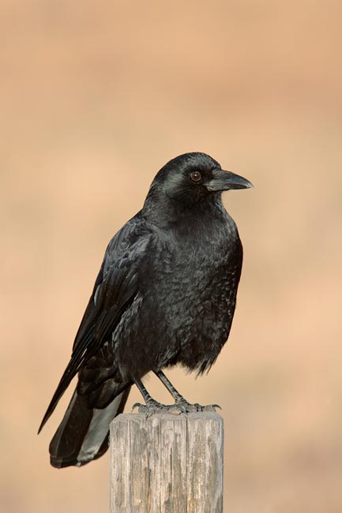
What is the main morphological difference in their eyes?
Eye placement in the skull

Slide 9
How do you expect the visual fields of these species to be in relation to YOURS?
Draw a schematic representation

Slide 10

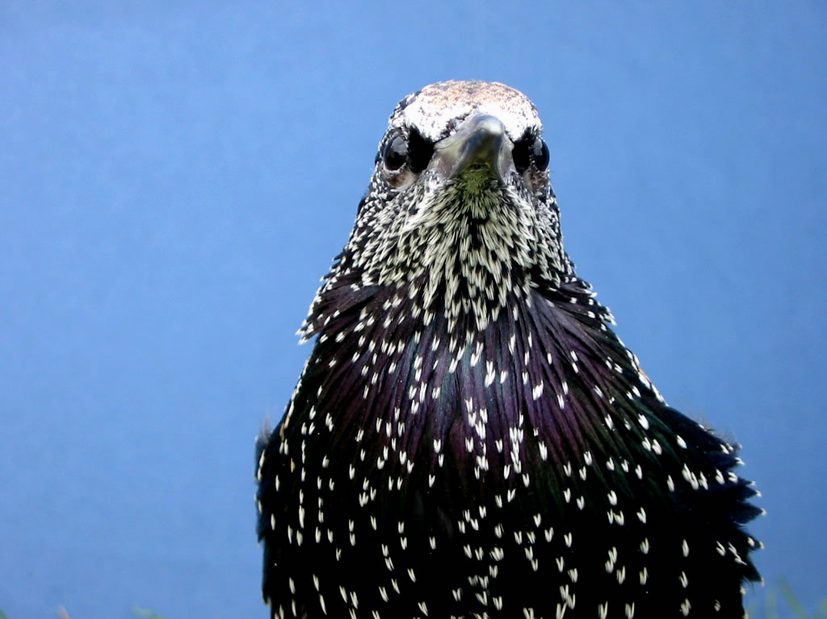
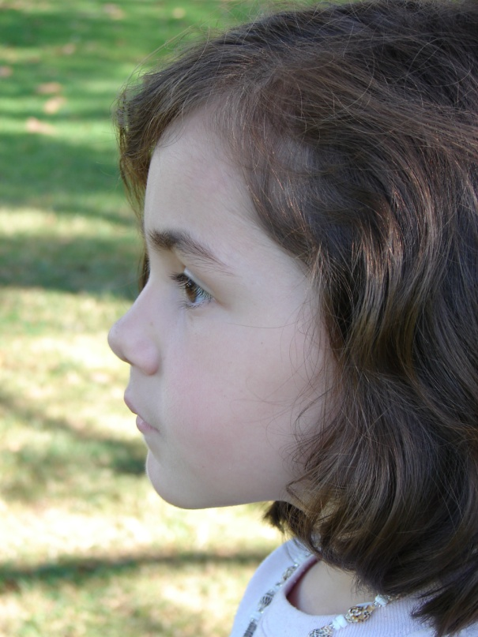
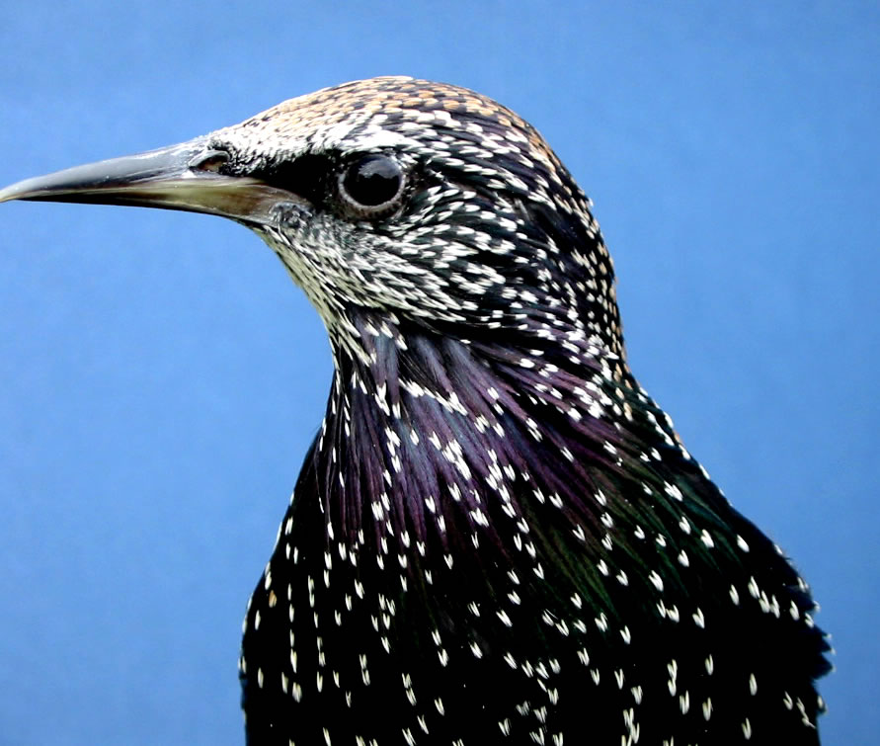

Slide 11
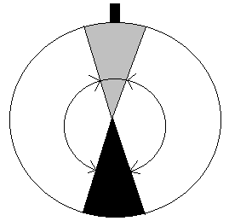
Visual fields: the limits of the space around an animal from which information can be obtained.
direction of the bill
binocular area (food handling)
Lateral areas (detection of
predators, conspecifics, etc.)
blind area
top-view

Slide 12
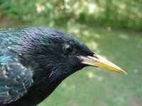
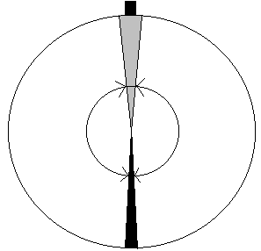
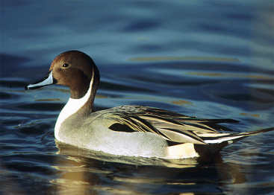
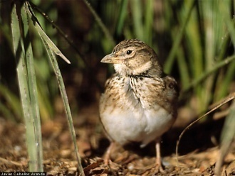
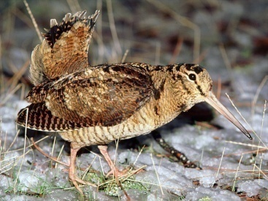
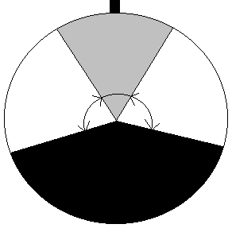
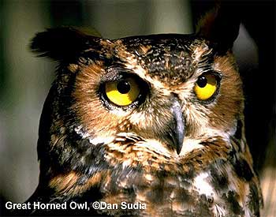
Inter-specific differences in avian visual perception
Type 1
Type 2
Type 3
top-views

Slide 13
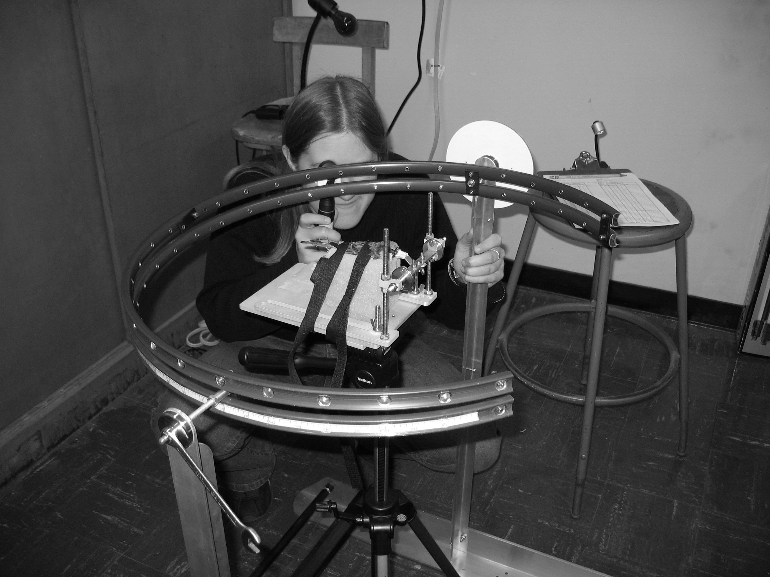
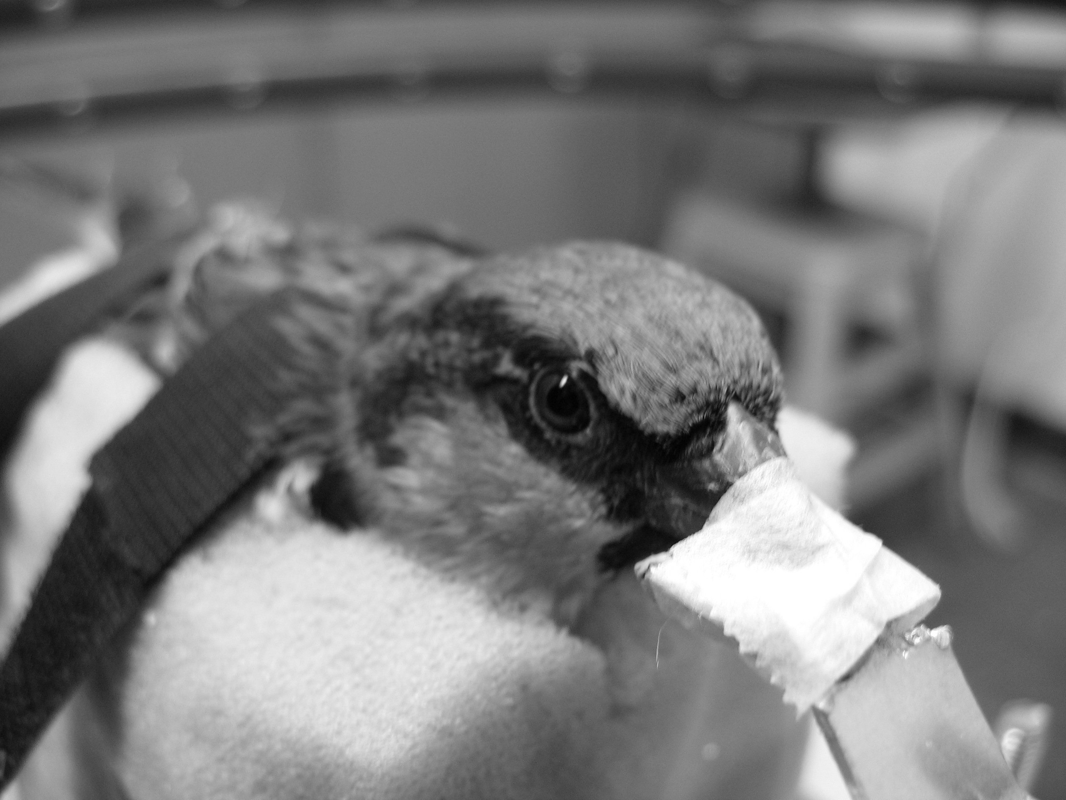
Visual field: eye exam on birds
ophthalmoscope + visual field apparatus

Slide 14
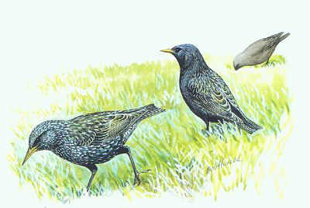
How do birds eat?
Head-up = vigilance or scanning
Head-down: eating or pecking or foraging
Do all species use the same body movements when it comes time to grab a bite?
Do all species have the eyes placed in the same spot in the skull?

Slide 15
Which species will be able to “see” while foraging?
Why are they able to see?
Why is that important for them?

Slide 16
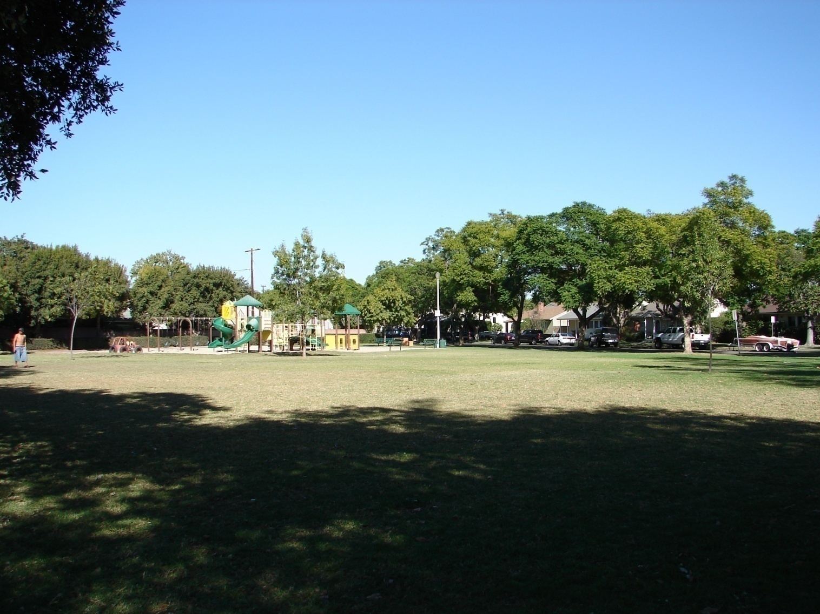

Slide 17
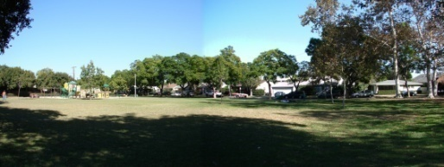
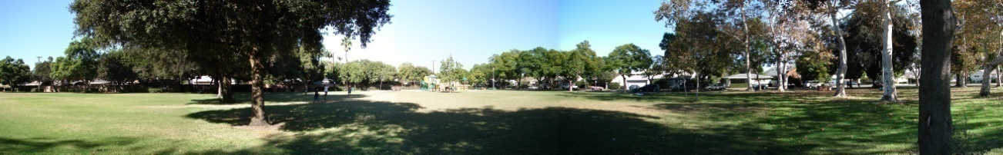

Slide 18
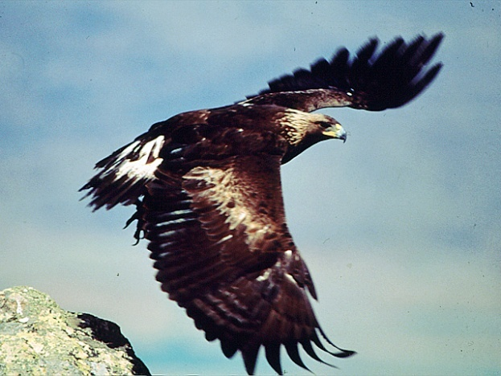
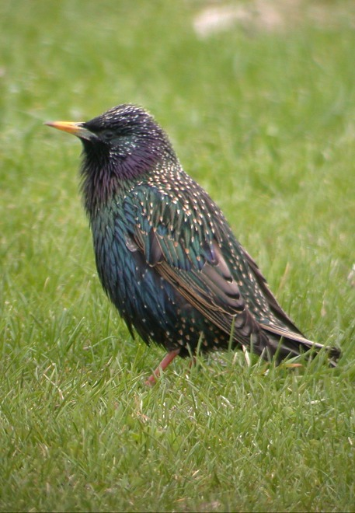
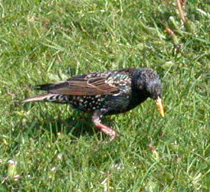
Blind area
Area from with
visual information available
Head down
Head up

Slide 19
How do humans track visual targets within the visual field?
Mostly through eye movements.
Why do we need to move our eyes?
Human retina

Slide 20
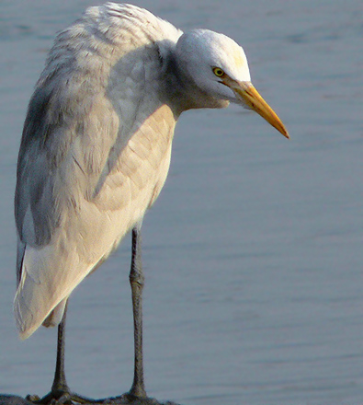
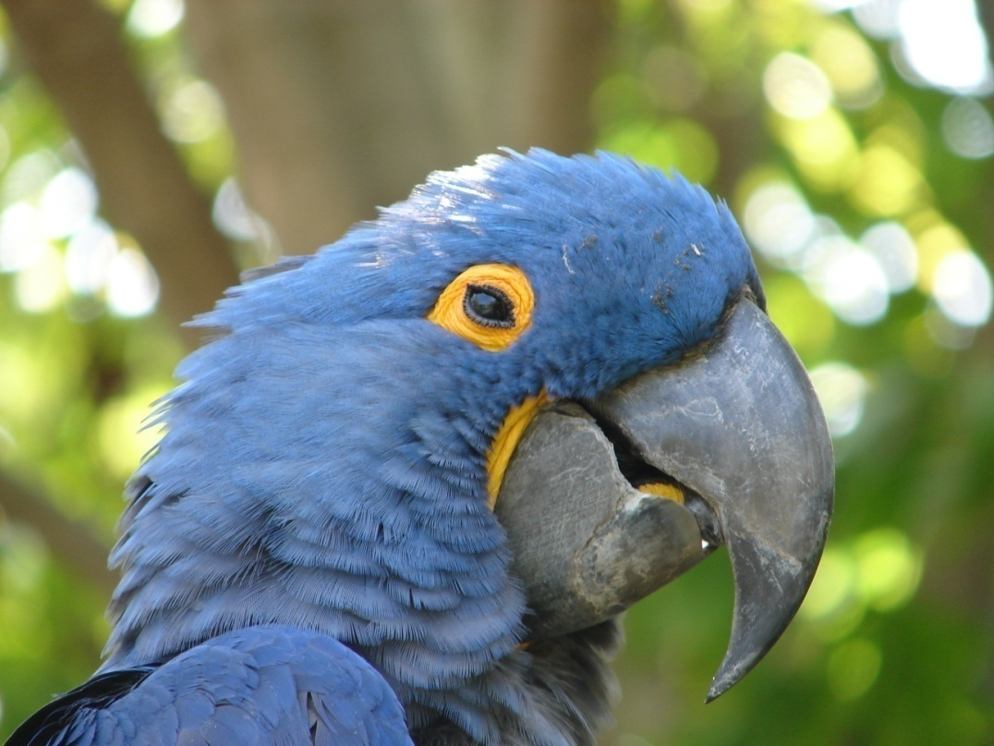
Birds have limited eye movements!
How are they supposed to follow a visual target?

Slide 21

How often do birds move their heads?
Use the tally counters to count EVERY single (and subtle) head movement of a house finch foraging.
Overall video length = 83 seconds.
Calculate the rate per minute and per second.

Slide 22
What have you learned today?
Variations in the visual field of different bird species in relation to humans.
How birds move their heads to track visual targets.
Make predictions.

